Slide 1
CS492 - Operating Systems History of Operating Systems
Georgios Portokalidis & Jun Xu
Reading: Zybook Ch 1.2
Slides credit: Antonio Barbalace

Slide 2
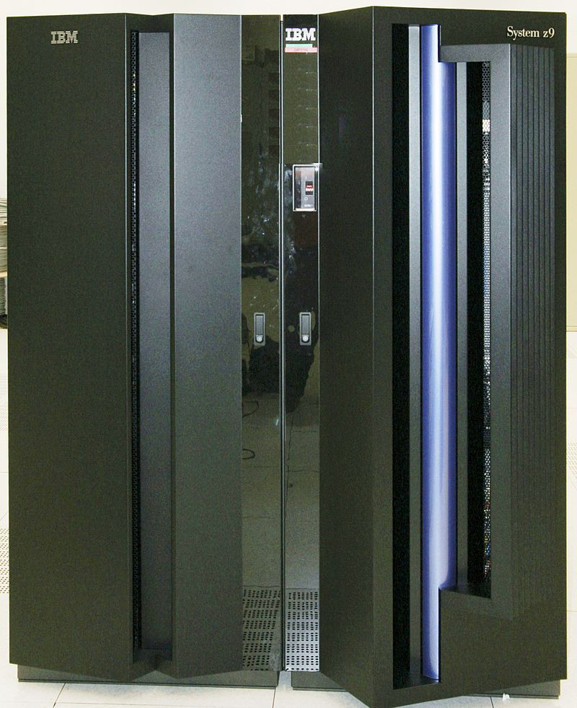
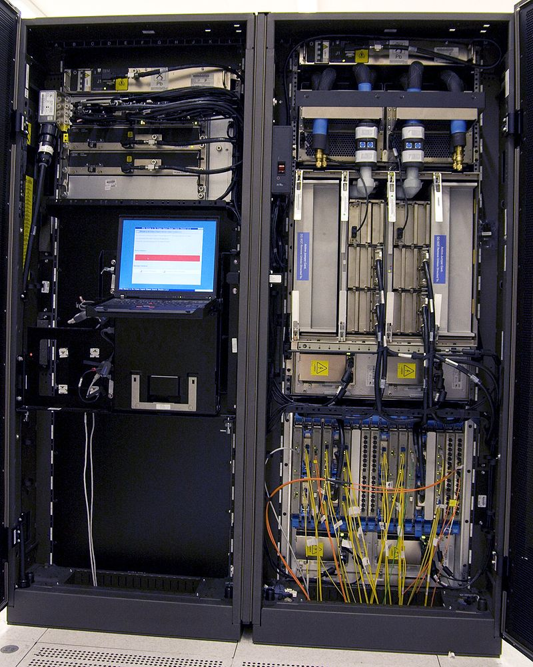
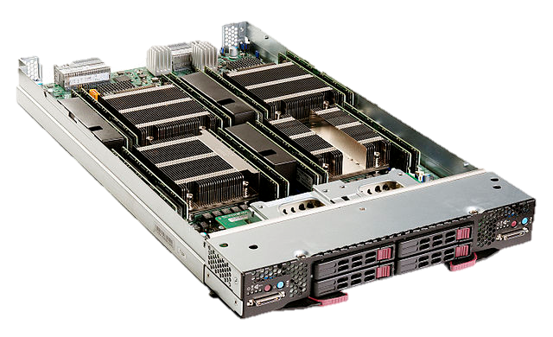
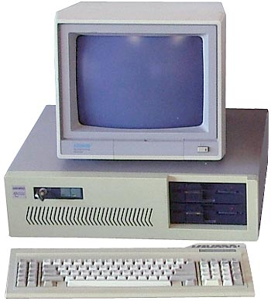
Different types of Computers (1)
Mainframes
Servers
Workstation/desktop
…

Slide 3
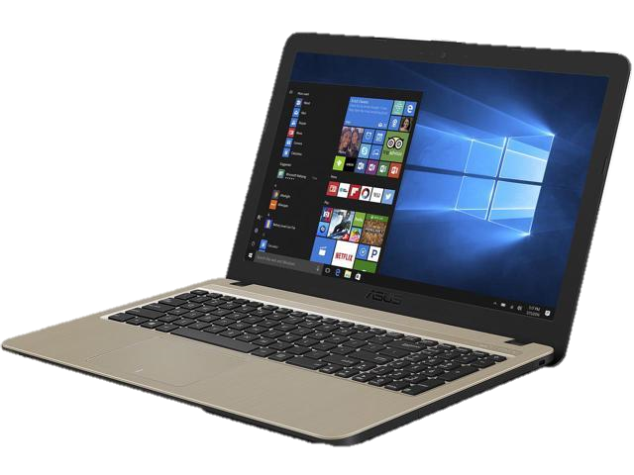
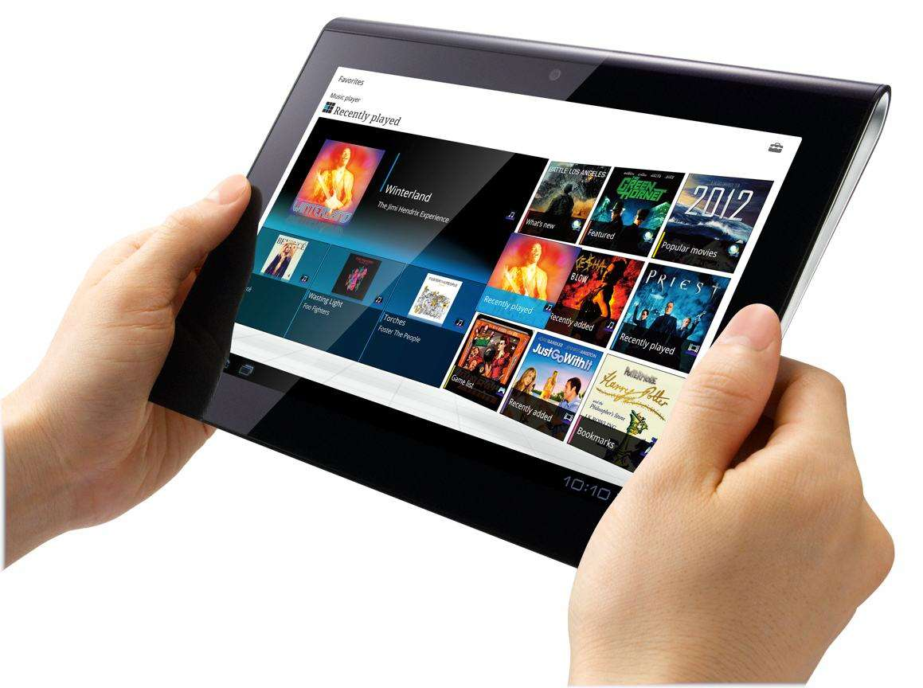
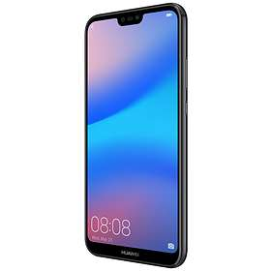
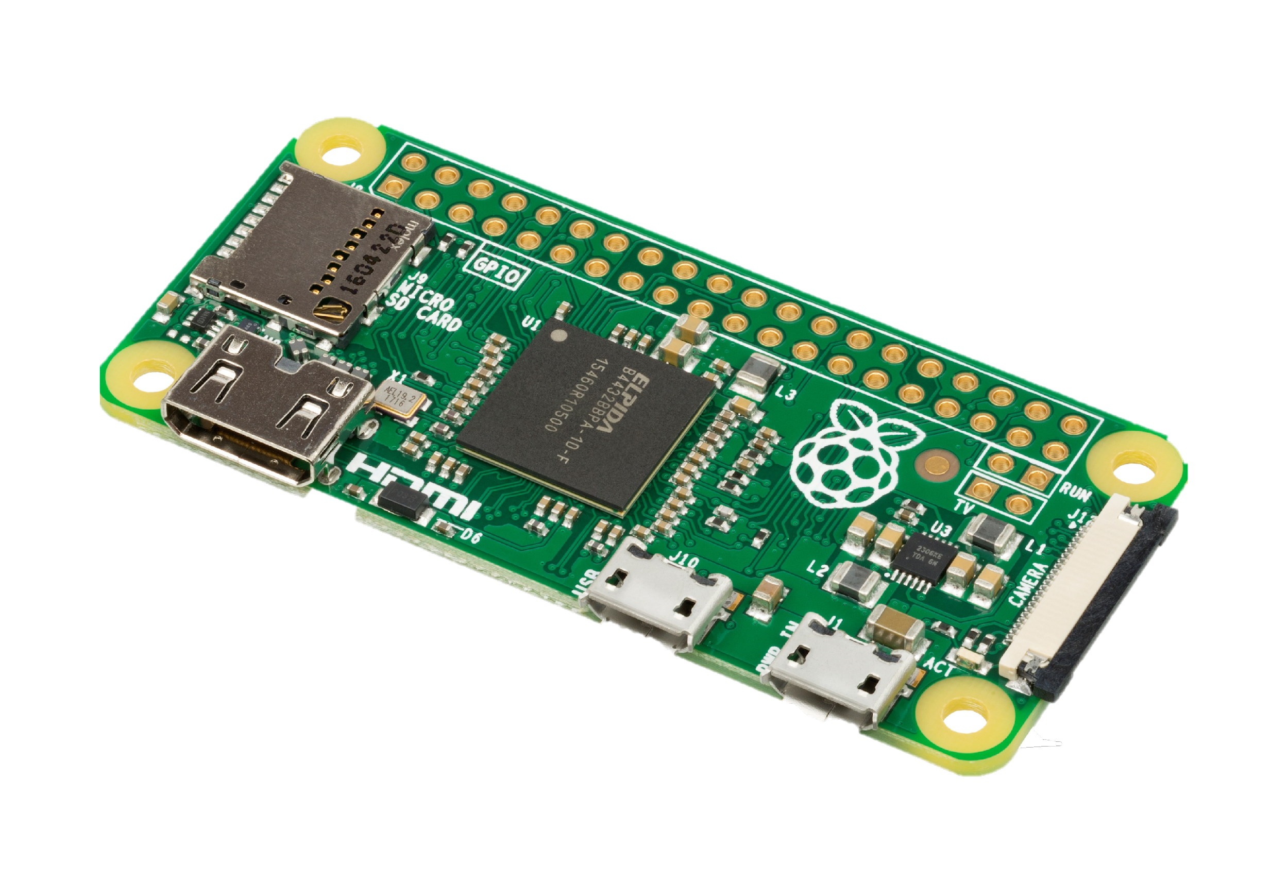
Different types of Computers (2)
…
Laptop
Tablet
Smartphone
Embedded

Slide 4
History of Operating Systems
1945-1955 Vacuum Tubes
1955-1965 Transistors and Batch Systems
1967-1980 ICs and Multiprogramming
1980-1990 Personal Computers
1990-present Mobile Computers

Slide 5
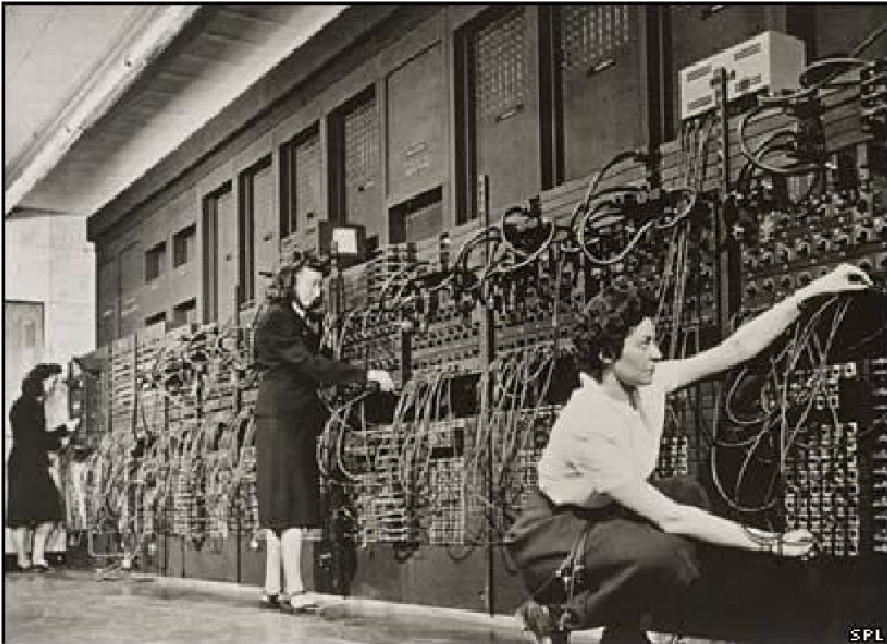
OS History: Before OSes
ENIAC, 1943
Notes:
Electronic Numerical Integrator and Computer
MUCH FASTER THAN MECHANICAL COMPUTERS
Although ENIAC was designed and primarily used to calculate artillery firing tables for the United States Army's Ballistic Research Laboratory,^{[5][6]} its first program was a study of the feasibility of the thermonuclear weapon.^{[7][8]} ENIAC was completed in 1945 and first put to work for practical purposes on December 10, 1945
ENIAC's design and construction was financed by the United States Army, Ordnance Corps, Research and Development Command, led by Major General Gladeon M. Barnes

Slide 6
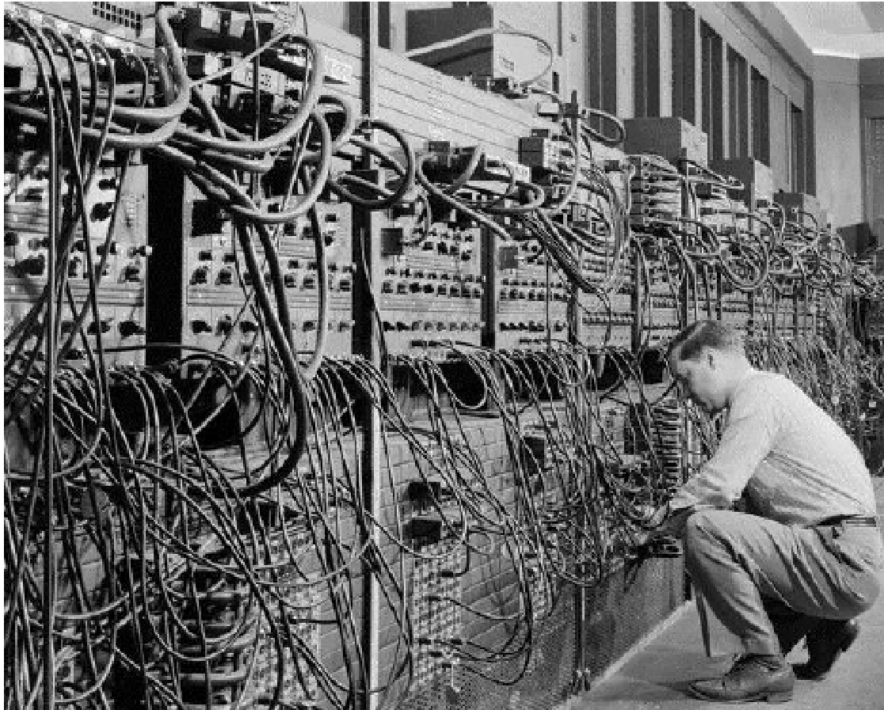
ENIAC (More)
Coding by cable connections (reprogramming)
Notes:
Like a big FPGA
This is about IO and Human-machine interface: it means the OS also helps about IO and HM interface

Slide 7
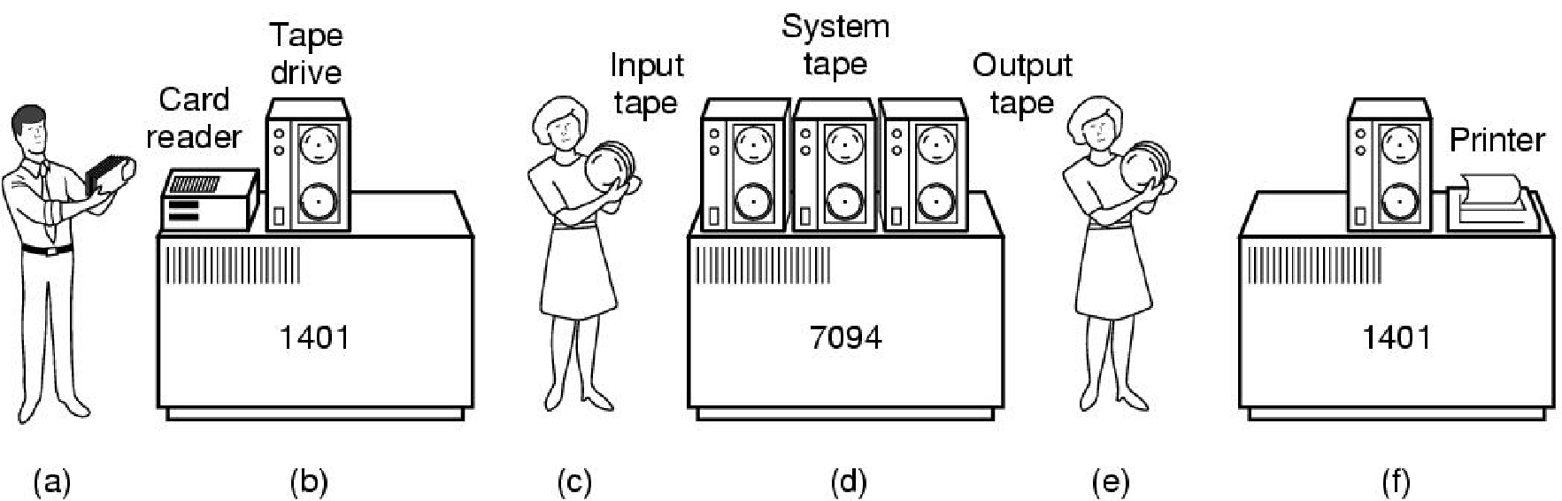
Transistors and Batch Systems
An early batch system. (a) Programmers bring cards to 1401. (b)1401 reads batch of jobs onto tape. (c) Operator carries input tape to 7094. (d) 7094 does computing. (e) Operator carries output tape to 1401. (f) 1401 prints output. (MOS Figure 1-3)
Notes:
This is about IO and Human-machine interface: it means the OS also helps about IO and HM interface
Programmers have to prepare their code on a punched card (or a tape) and arrive at the facility an then run the code

Slide 8
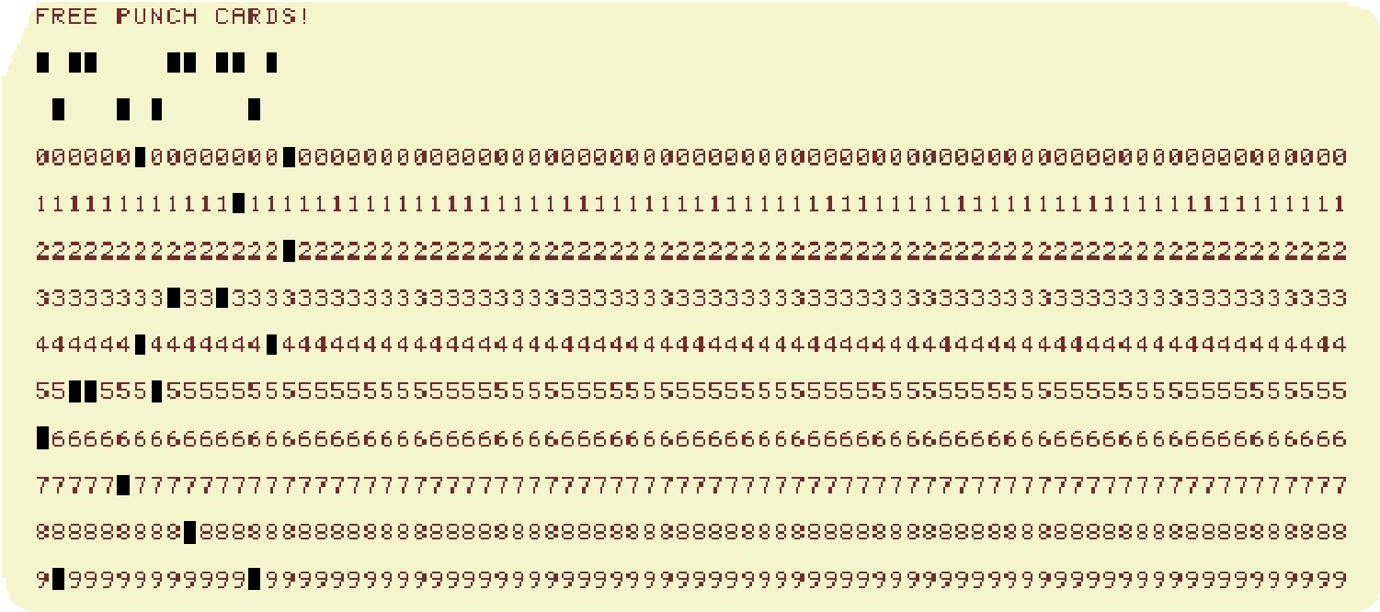
Punch Cards
Coding by punch cards
Notes:
This is about IO and Human-machine interface: it means the OS also helps about IO and HM interface
Programmers have to prepare their code on a punched card (or a tape) and arrive at the facility an then run the code

Slide 9
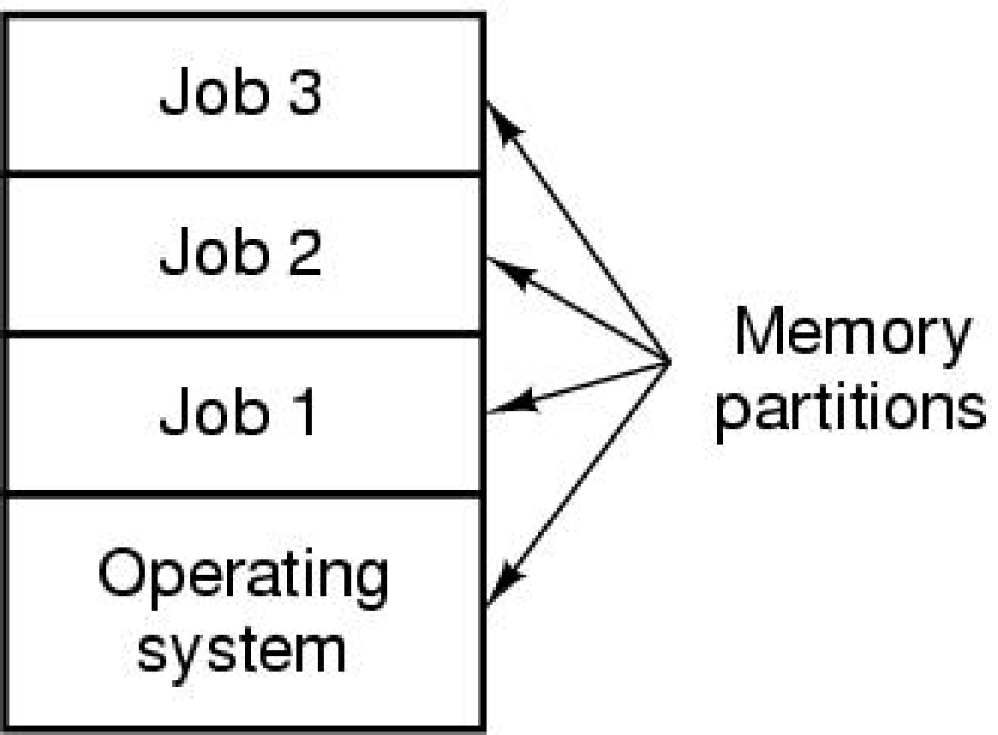
ICs and Multiprogramming
A multiprogramming system with three jobs in memory (MOS Figure 1-5)

Slide 10
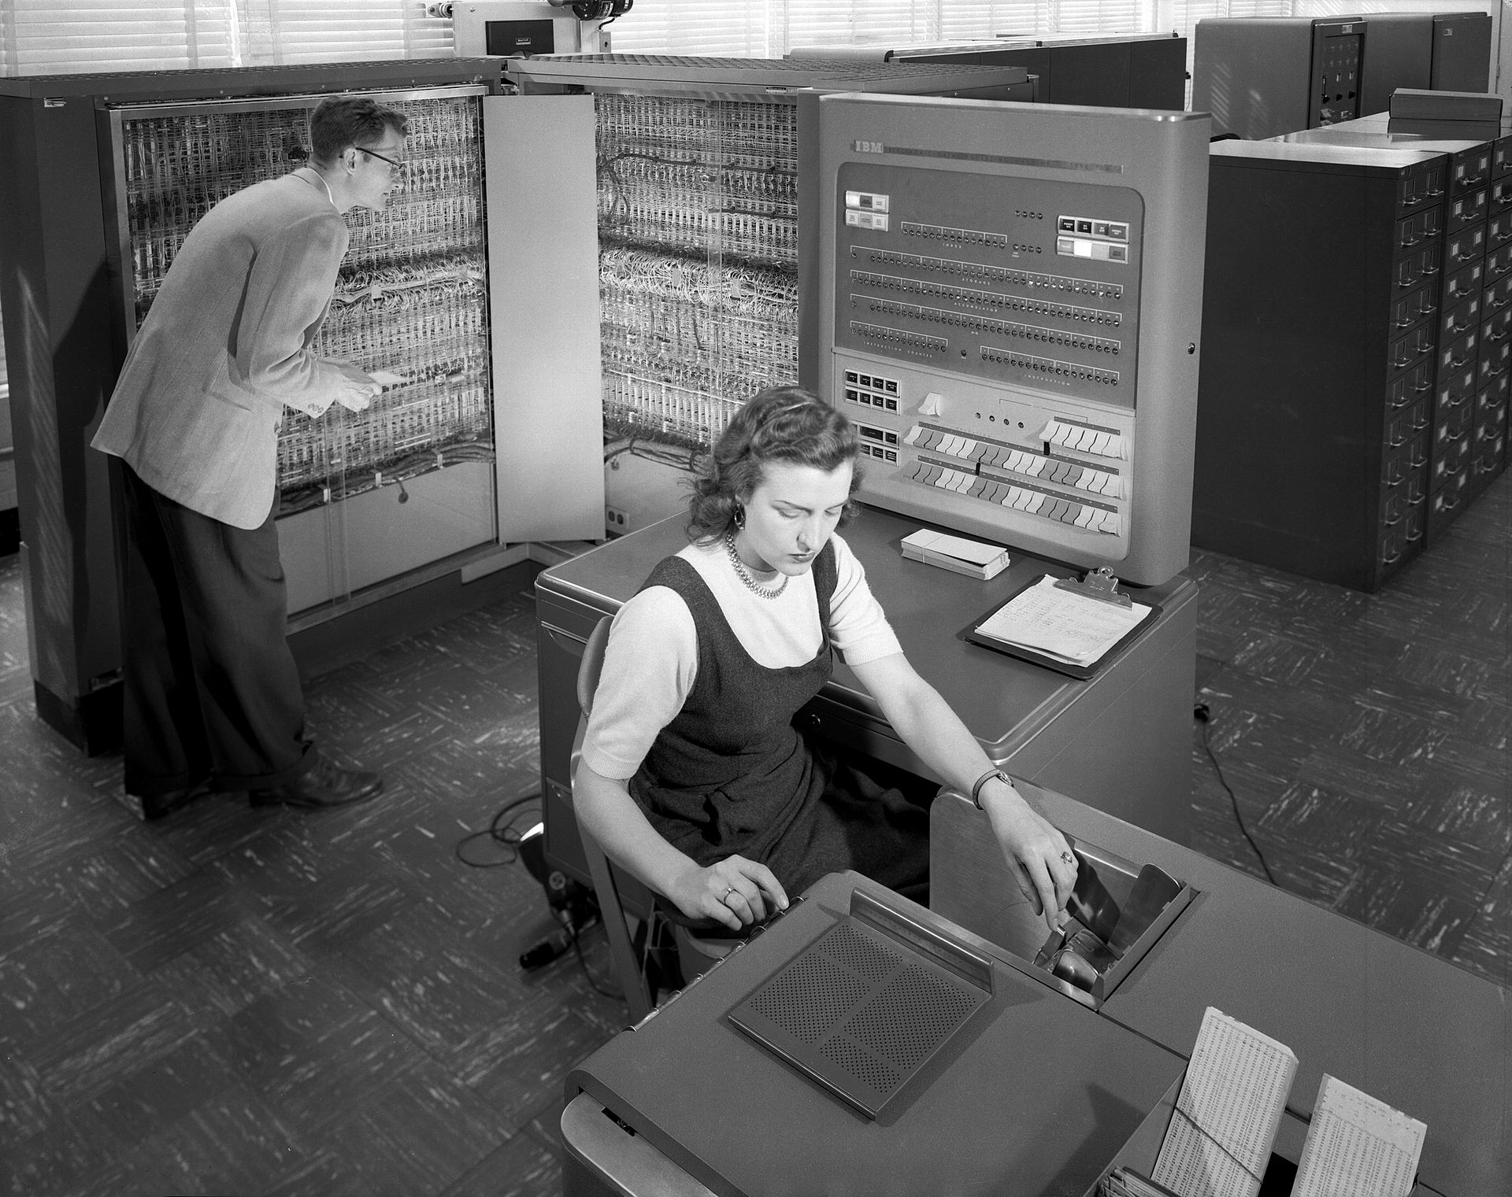
The first OS (1956)
GM-NAA I/O system General Motors and North American Aviation
For the IBM 704 mainframe
Shared routines to the programs
Common access to the I/O devices
Notes:
The first operating system used for real work was GM-NAA I/O, produced in 1956 by General Motors' Research division^{[2]} for its IBM 704.^{[3]} Most other early operating systems for IBM mainframes were also produced by customers.^{[4]}
Early operating systems were very diverse, with each vendor or customer producing one or more operating systems specific to their particular mainframe computer. Every operating system, even from the same vendor, could have radically different models of commands, operating procedures, and such facilities as debugging aids. Typically, each time the manufacturer brought out a new machine, there would be a new operating system, and most applications would have to be manually adjusted, recompiled, and retested.

Slide 11
OS on Mainframes
IBM OS/360 for mid-range and large systems
Multics (Multiplexed Information and Computing Service)
MIT, GE, and Bell labs, 1964
First OS provides security and hierarchical file systems

Slide 12

The rise of UNIX
AT&T Bell Laboratories, the late 1960s
Ken Thompson, Dennis Ritchie
UNIX based on Multics, but vastly simplified
Many descendants (see next slide)

Slide 13
Minicomputers (1980-)
Personal computing
Computers cheap, so everyone has a PC
Limited hardware resources initially
OS becomes a subroutine library
One application at a time (MSDOS, CP/M, …)
Eventually PCs become powerful
OS regains all the complexity of a “big” OS
https://www.facebook.com/BBCArchive/videos/133157385315377

Slide 14
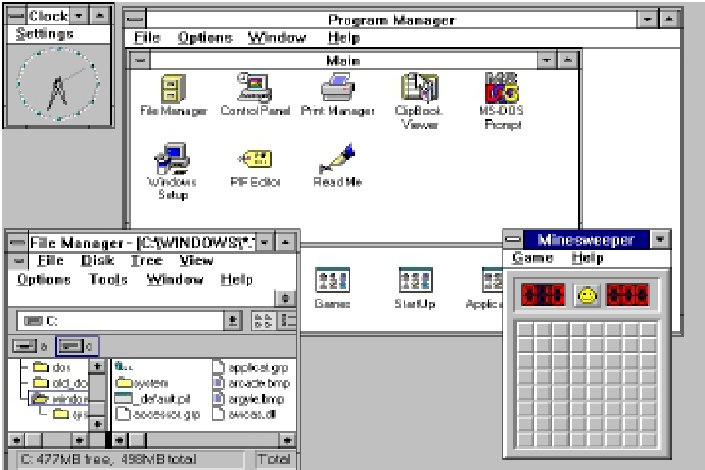
The Personal Computer Era
CP/M-80 OS for the 8080 / 8085 / Z-80
MSDOS: Microsoft's first OS
New OS feature: graphical user interface
Windows 3.1

Slide 15
Popular Operating Systems for Personal Computers
Microsoft Windows
Apple MacOS/OS X
UNIX variants
Systems V
BSD
IBM Aix
Sun Solaris
...
Linux
...

Slide 16
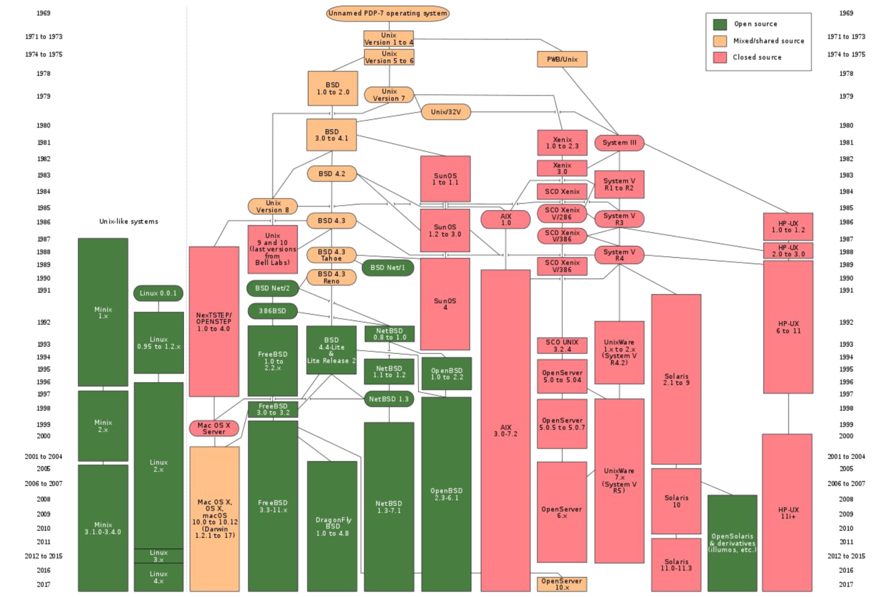
Evolution of UNIX

Slide 17
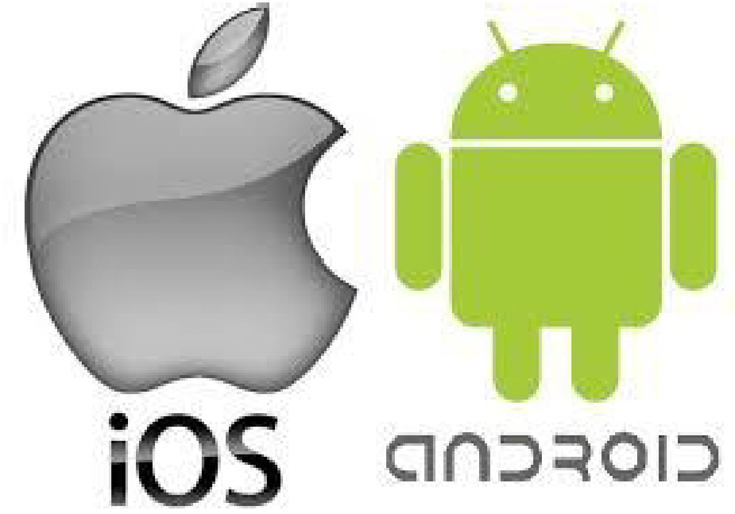
The Mobile Era
Mobile Operating System (MobiOS)
Laptops, tablets, PDA, handheld, phones
Small, portable, inexpensive
Examples
Android
iOS
Symbian
Windows Phone/Mobile
Notes:
Single user, while workstation and servers are multiuser

Slide 18
Other Operating Systems
Embedded OS
No customization
Sensor-node OS
Limited power
Real-time OS
Time as a key parameter
Hard real-time
Soft real-time
Smart card OS
Very limited capabilities

Slide 19
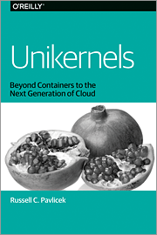


Why it is Important to Study Operating Systems Today?
Renew interest in OS from major IT Companies
The rise of unikernels appliances (Cloud)
In 2016 Google released Fucsia
In 2017 Amazon took stewardship of FreeRTOS
…
Notes:
Cloud market
Car/drone market

Slide 20
TODOs Before Next lecture
Study zyBook chapter 1.3
Complete relevant zyBook activity
zyBook assignment “2-Introduction part2”

